Slide 1
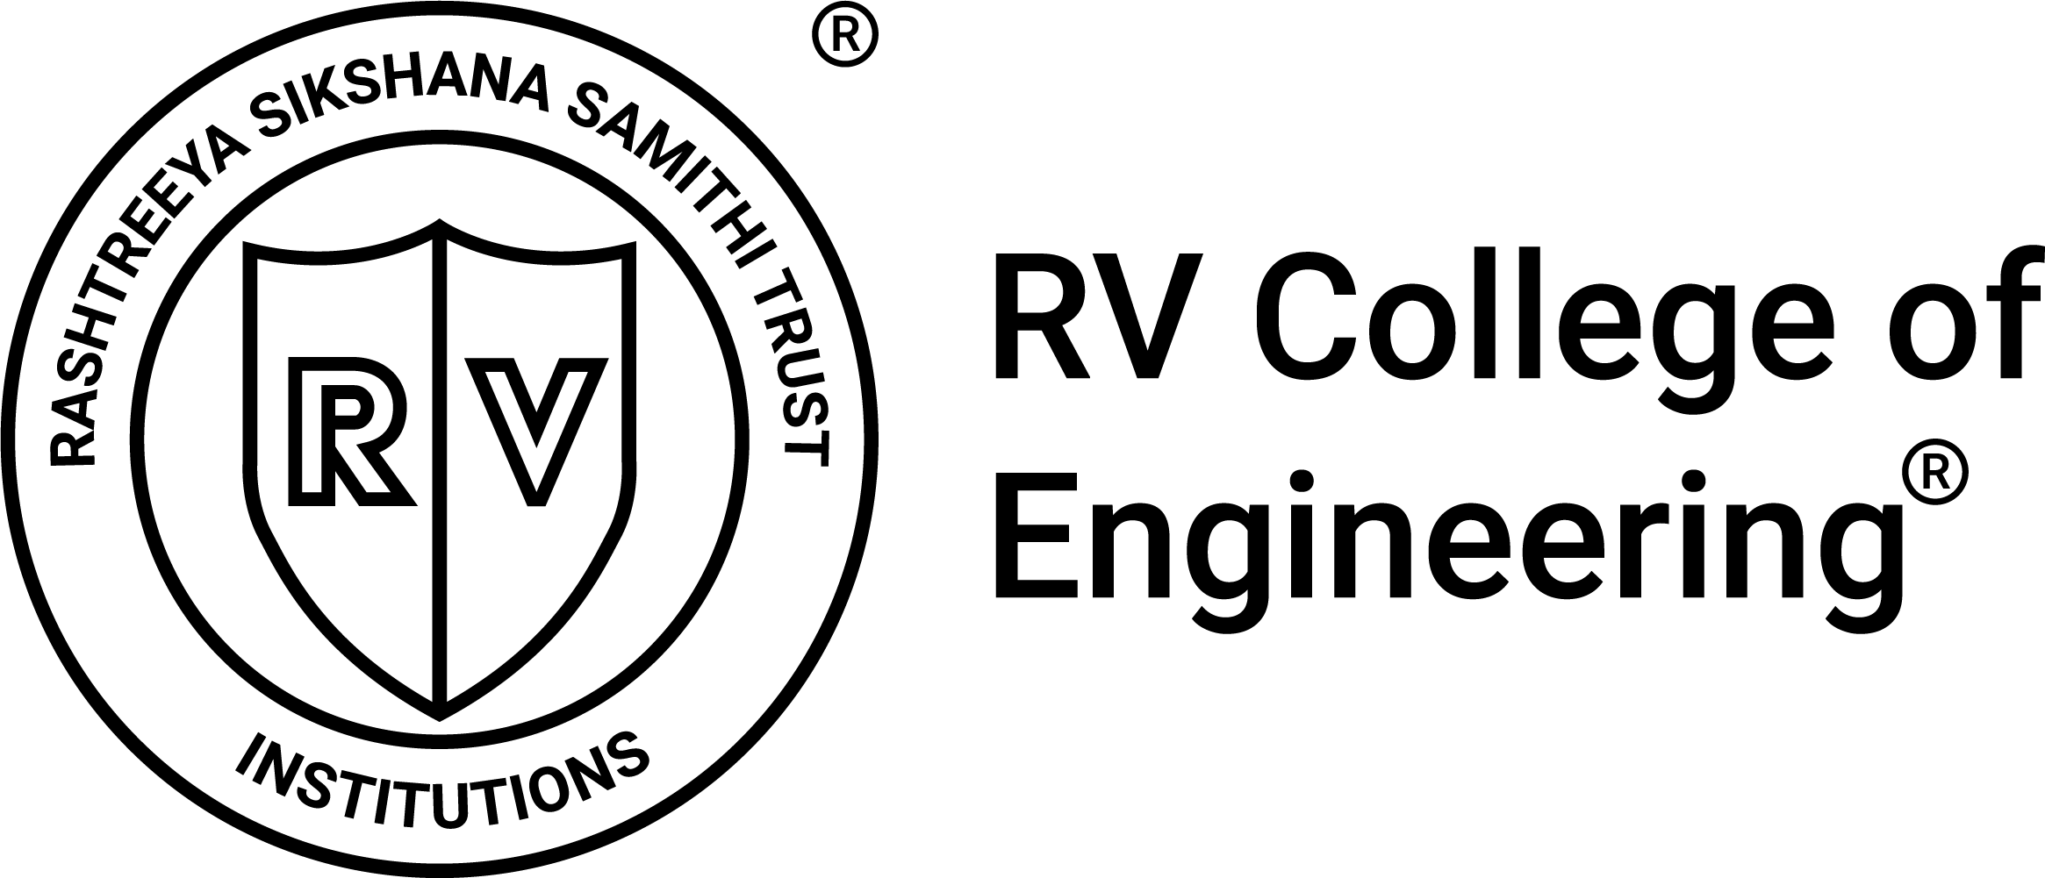

RV College of
Engineering
What Is AI & ML? Your New Helper
AI = Computer Brain: Think of it as a smart helper that learns from past stitching patterns. ML = Learning from Data: Just like you learn by practicing stitches, ML learns by looking at numbers like how fast you sew or how thick the cloth is.
Why It Helps You:
Fewer Mistakes: Alerts you when you’re about to make more stitch errors.
Work Steady: Suggests best speed so your hands and machine don’t get overwhelmed.
More Earnings: Less rework means more finished pieces and more pay.
Notes:
‹#›

Slide 2
RV College of
Engineering
AI in Your Daily Stitching
Predict High-Error Batches: AI checks your speed, cloth thickness, and experience to warn if errors may spike.
Set Best Speed: It tells you a comfortable stitches-per-minute so fewer loose threads or skipped stitches.
Right Cloth, Right Settings: For very thick cloth, AI suggests slowing down; for thin cloth, you can safely speed up
One Light, Zero Code: See a green light for “go ahead” or red light for “slow down.” No typing, no apps.
Notes:
‹#›

Slide 3
RV College of
Engineering
Layman Analysis & Take-Home Points
✔️ Reliable Safe Batches: Most green‐lighted batches really are safe (88% recall).
✔️ Strong Warning Signal: Red‐light warnings are accurate (82% precision), so workers can trust slowdown alerts.
⚠️ Missed Risks: AI still misses about 36 out of 100 truly risky batches—so human judgment remains important.
💡 Practical Use:
Green Light (0): Keep stitching at this speed/setting.
Red Light (1): Slow down or ask for help—AI caught a pattern that may cause more mistakes.
📈 Business Impact: Fewer reworks → faster production → more pay for safe batches
Notes:
‹#›

